Slide 1
Chapter 3. Trends
3.1 Deterministic Versus Stochastic Trends
3.2 Estimation of Constant Mean
3.3 Regression Methods
3.4 Reliability and Efficiency of Regression Estimates (skipped)
3.5 Interpreting Regression Output
3.6 Residual Analysis

Slide 2
3.1 Deterministic Versus Stochastic Trends
Let {Y_{t}} be process which is constructed as follows:
Y_{t} = μ_{t} + X_{t}
We might assume that X_{t}, the unobserved variation around μ_{t}, has zero mean for all t so that indeed μ_{t} is the mean function for the observed series Y_{t}.
The process {Y_{t}} is said to have a deterministic trend if μ_{t} is a deterministic function of t.
Note: The stochastic trend is not required in this course.

Slide 3
3.2 Estimation of a Constant Mean
Suppose the process {Y_{t}} is modeled by
Y_{t} = μ + X_{t}
where μ is a constant and {X_{t}} is a process with E(X_{t}) = 0 for all t.
Objective:
To estimate μ from our observed time series Y₁, Y₂, …, Y_{n}.

Slide 4
3.2 Estimation of a Constant Mean
The most common estimate of μ is the sample mean or average defined as
is an unbiased estimator of μ since .

Slide 5
3.2 Estimation of a Constant Mean
Stationary Process
Suppose that {X_{t}} is a stationary time series with autocorrelation function ρ_{k}. Then,
If the series {X_{t}} is just white noise, then

Slide 6
3.2 Estimation of a Constant Mean
Suppose that X_{t} = e_{t} – ½ e_{t–1}. We find that ρ₁ = −0.4 and ρ_{k} = 0 for k > 1. In this case, we have
So, the negative correlation at lag 1 has improved the estimation of mean compared with the estimation obtained in the white noise situation.

Slide 7
3.2 Estimation of a Constant Mean
If ρ_{k} ≥ 0 for all k ≥ 1, then will be larger than
γ ₀ /n. Here the positive correlations make estimation of the mean more difficult than in the white noise case.
In general, some correlations will be positive and some negative, and Eq. (3.2.1) must be used to assess the total effect.

Slide 8
3.2 Estimation of a Constant Mean
If the autocorrelation function decays quickly enough with increasing lags that
then
Suppose that ρ_{k} = φ ^{|k|} for all k, where –1 < φ < 1. Then,

Slide 9
3.2 Estimation of a Constant Mean
Nonstationary Process
In the case of {X_{t}} (or equivalently, {Y_{t}}) to be a nonstationary process (but with a constant mean), the precision of the sample mean as an estimate of μ can be strikingly different.

Slide 10
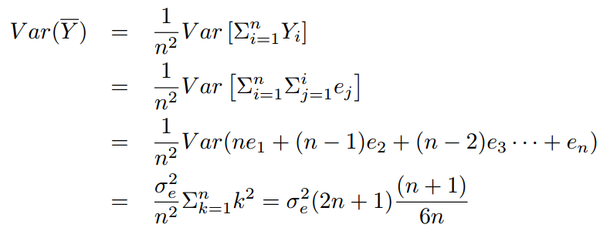
3.2 Estimation of a Constant Mean
If {X_{t}} is a random walk process, then
So, increases as the sample size n increases. This is clearly unacceptable.

Slide 11
3.3 Regression Methods
Linear and Quadratic Trends in Time
Consider the deterministic time trend expressed as
where the slope and intercept, β₁ and β₀ respectively, are unknown parameters.
By using the least squares (or regression) method is to choose as estimates of β₁ and β₀ values that minimize

Slide 12
3.3 Regression Methods
Denoting the estimates of β₁ and β₀ by respectively, we find that
where is the average of 1, 2, …, n.

Slide 13
3.3 Regression Methods
Cyclical or Seasonal Trends
Consider the average monthly temperature in Example 1.3. Here we assume that the observed time series can be represented as
where E(X_{t}) = 0 for all t.
The most general assumption for μ_{t} is that there are 12 constants (parameters), β ₁, β₂, …, and β₁₂, giving the expected average temperature for each of the 12 months.

Slide 14
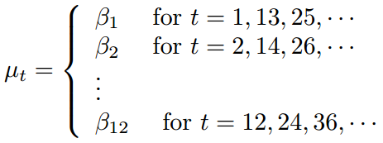
3.3 Regression Methods
We may write
This is sometimes called a seasonal means model.

Slide 15
3.3 Regression Methods
To fit such a model, we need to set up indicator variables (sometimes called dummy variables) that indicate the month to which each of the data point pertains.
Assume there is no intercept term in μ_{t},
where

Slide 16
3.3 Regression Methods
Regression Results (no intercept term)
Month (i) | Estimate (β_{i}) | Std. Error | t-value | Pr(>|t|)
Jan | 16.608 | 0.987 | 16.8 | <0.0001
Feb | 20.650 | 0.987 | 20.9 | <0.0001
Mar | 32.475 | 0.987 | 32.9 | <0.0001
Apr | 46.525 | 0.987 | 47.1 | <0.0001
May | 58.092 | 0.987 | 58.9 | <0.0001
Jun | 67.500 | 0.987 | 68.4 | <0.0001
Jul | 71.717 | 0.987 | 72.7 | <0.0001
Aug | 69.333 | 0.987 | 70.2 | <0.0001
Sep | 61.025 | 0.987 | 61.8 | <0.0001
Oct | 50.975 | 0.987 | 51.6 | <0.0001
Nov | 36.650 | 0.987 | 37.1 | <0.0001
Dec | 23.642 | 0.987 | 24.0 | <0.0001

Slide 17

3.3 Regression Methods
Assume there is an intercept
where

Slide 18
3.3 Regression Methods
Regression Results (with an intercept)
 | Estimate (β_{i}) | Std. Error | t-value | Pr(>|t|)
Intercept | 16.608 | 0.987 | 16.83 | <0.0001
Feb | 4.042 | 1.396 | 2.90 | <0.0001
Mar | 15.867 | 1.396 | 11.37 | <0.0001
Apr | 29.917 | 1.396 | 21.43 | <0.0001
May | 41.483 | 1.396 | 29.72 | <0.0001
Jun | 50.892 | 1.396 | 36.46 | <0.0001
Jul | 55.108 | 1.396 | 39.48 | <0.0001
Aug | 52.725 | 1.396 | 37.78 | <0.0001
Sep | 44.417 | 1.396 | 31.82 | <0.0001
Oct | 34.367 | 1.396 | 24.62 | <0.0001
Nov | 20.042 | 1.396 | 14.36 | <0.0001
Dec | 7.033 | 1.396 | 5.04 | <0.0001

Slide 19
3.5 Intrepeting Regression Output
Consider a time series {Y_{t}} which has the following form
Y_{t} = μ_{t} + X_{t}
where E(X_{t}) = 0 for all t.
The regression output for the linear time trend
μ_{t} = β₀ + β₁t are given as follows:
 | Estimate | Std. Error | t-value | Pr(>|t|)
Intercept | –1.007888 | 0.297245 | – 3.39 | 0.00126
Time | 0.134087 | 0.008475 | 15.82 | < 0.0001

Slide 20
3.5 Intrepeting Regression Output
Notes on interpreting the result:
The standard deviations of the coefficients labeled “Std. Error” are only appropriate under the assumption of the {X_{t}} being white noise.
The t-values or t-ratios are just the estimated regression coefficients, each divided by their respective standard errors. If {X_{t}} is normally distributed white noise, then these ratios provide appropriate test statistics for checking whether the regression coefficients are equal to 0 or not.

Slide 21
3.6 Residual Analysis
Consider
Y_{t} = μ_{t} + X_{t}
The unobserved stochastic component {X_{t}} can be predicted by the residual
We use the term predictor for an estimate of an unobserved random variable, while the term estimate for the guess of an unknown parameter.

Slide 22
3.6 Residual Analysis
If the trend model is reasonably correct, then the residuals should behave roughly like the true stochastic component, and various assumptions about the stochastic component can be assessed by looking at the residual.

Slide 23
3.6 Residual Analysis
If the stochastic component is white noise, then the residuals should behave roughly like independent (normal) random variables with zero mean and standard derivation being equal to the residual standard deviation s
where p is the number of parameters estimated in μ_{t} and n – p is the so-called degrees of freedom for s.

Slide 24
3.6 Residual Analysis
Since a least square fit of any trend containing a constant term automatically produces residuals with a zero mean, we might consider standardizing the residuals as .

Slide 25
3.6 Residual Analysis
Example 1.3 fitted with seasonal means
Randomness
If the stochastic component is white noise and the trend is adequately modeled, we would expect the plots which show a time series plot of the standardized residuals to suggest a rectangular scatter with no discernible trends whatsoever.
Exhibits 3.8, 3.9 and 3.10 show the randomness of the stochastic component.
Exhibits 3.8 and 3.9 show that there are no apparent patterns relating to different months of the year. Exhibit 3.10 also does not indicate any patterns that relating the relationship about the size of the residuals to the fitted trend values.

Slide 26
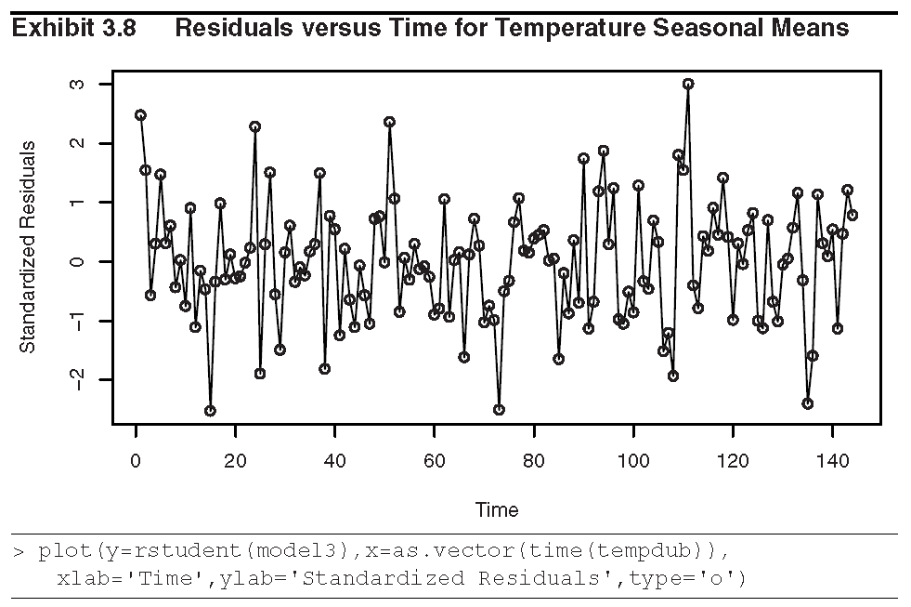

Slide 27
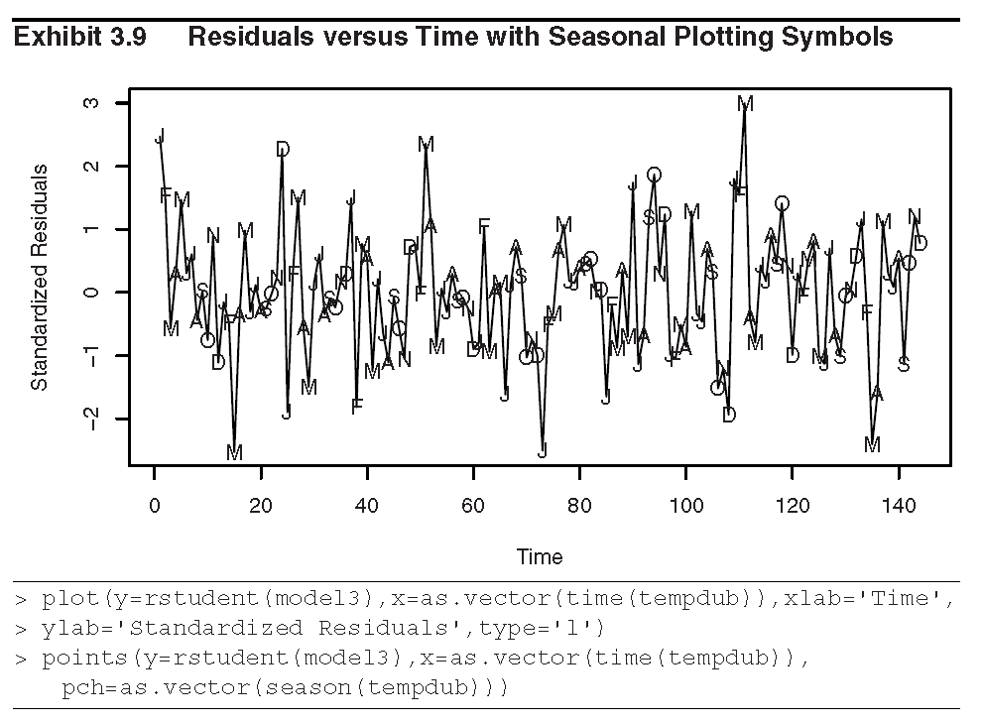

Slide 28
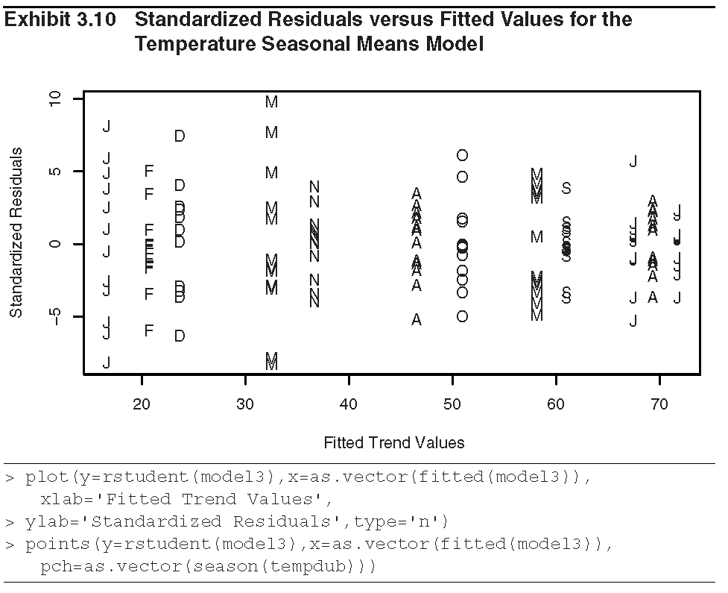

Slide 29
3.6 Residual Analysis
Normality
The histogram (Exhibit 3.11) and Q-Q plot (Exhibit 3.12) of standardized residuals supports the assumption of a normally distributed stochastic component in the model.
A more rigorous test, the Shapiro-Wilk test (see the reference in the textbook for details), also show that we cannot reject that the stochastic component of this model is normally distributed (Test statistics W = 0.9929 with a p-value of 0.6954).

Slide 30
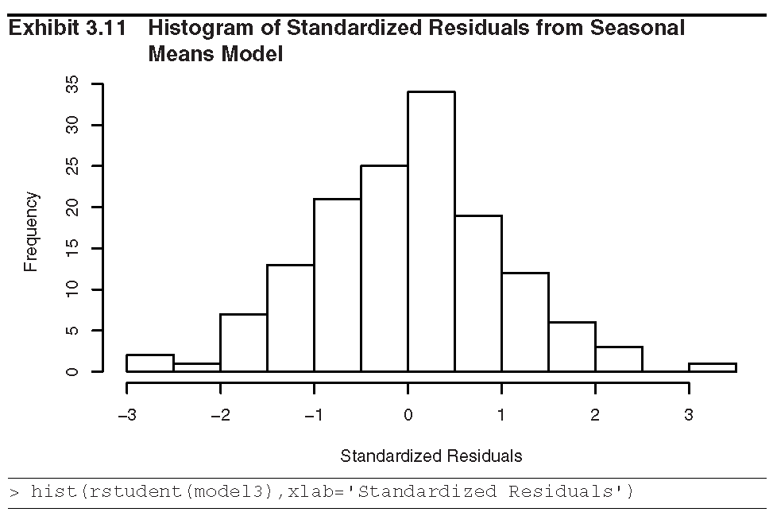

Slide 31
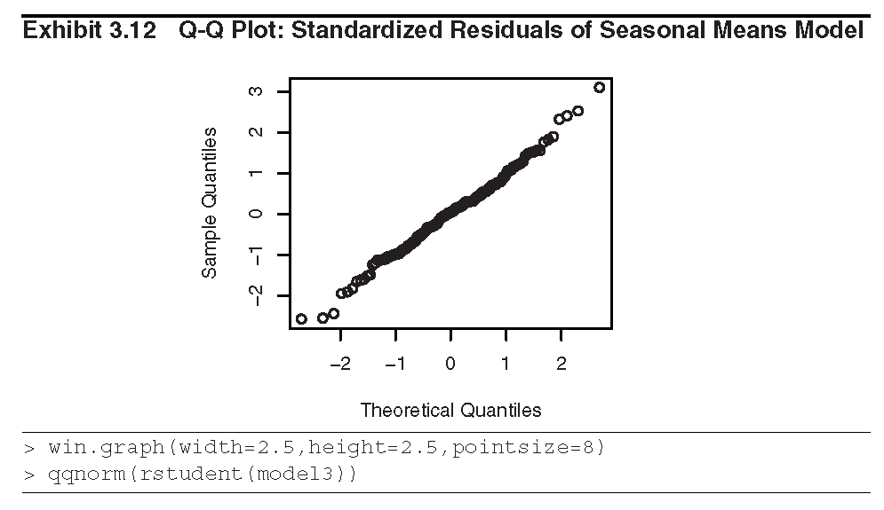

Slide 32
3.6 Residual Analysis
Independence
The runs test also suggest that we cannot reject independence of the stochastic component in the seasonal means model (p-value = 0.216).
  Runs above or below their median are counted.
  A small number of runs would indicate that neighboring residuals are positively dependent and tend to “hang together” over time.
  Too many runs would indicate that the residuals oscillate back and forth across their median. Then neighboring residuals are negatively dependent.
  Either too few or too many runs lead us to reject independence.

Slide 33
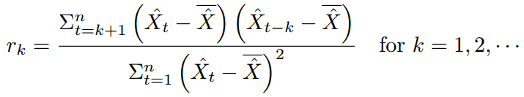
3.6 Residual Analysis
The sample autocorrelation function (Test for white noise)
We estimate the autocorrelation function for the standardized residuals by its sample autocorrelation function, r_{k}, at lag k as
where

Slide 34

3.6 Residual Analysis
The values of r_{k} are estimates of ρ_{k}
Exhibit 3.13 displays the sample autocorrelation for the standardized residuals from the seasonal means model of the temperature series.
All values of r_{k}, for k = 1, 2, …, 21, are within the two approximate standard errors of the sample autocorrelations, i.e., . So, none of the hypotheses ρ_{k} = 0 can be rejected at the usual significance level (0.05). So, it is reasonable to infer that the stochastic component of the series is white noise.

Slide 35
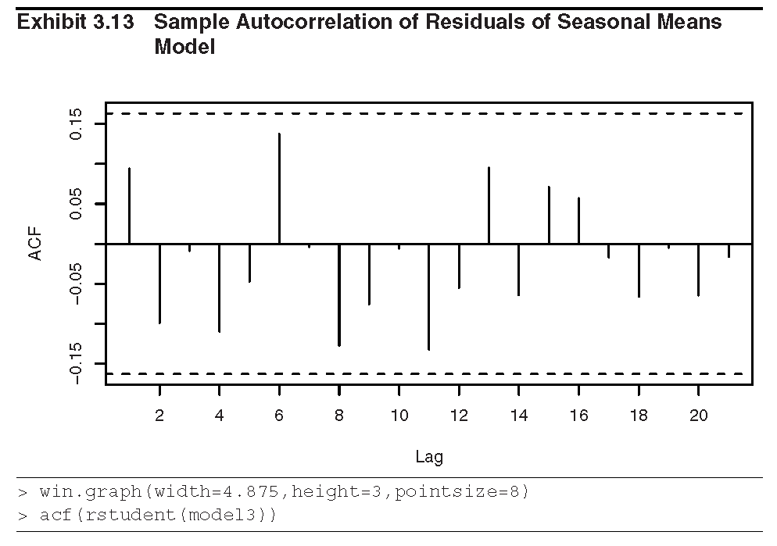

Slide 36
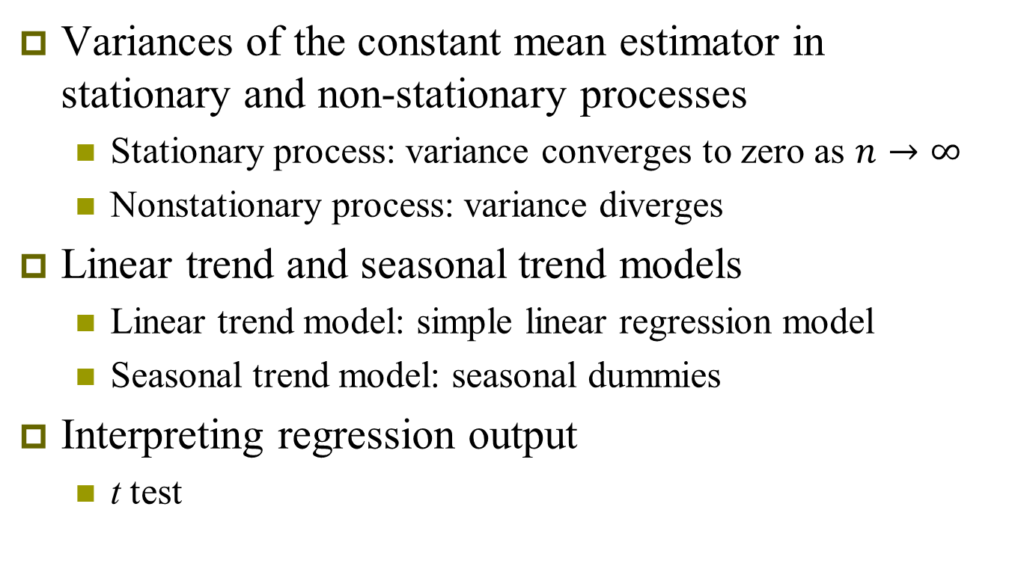
Summary
Variances of the constant mean estimator in stationary and non-stationary processes
  Stationary process: variance converges to zero as $n→∞$
  Nonstationary process: variance diverges
Linear trend and seasonal trend models
  Linear trend model: simple linear regression model
  Seasonal trend model: seasonal dummies
Interpreting regression output
  t test

Slide 37
Summary
Residual analysis
  Test about randomness
    Residual plots: Standardized residuals vs. time/fitted values
  Normality
    Histogram; Q-Q plot
  Independence
    Runs test
    ACF plot

